Slide 1
CNN(Convolutional Neural Network)

Slide 2
Convolutional Neural Network is a Deep Learning algorithm specially designed for working with Images and videos.
It takes images as inputs, extracts and learns the features of the image, and classifies them based on the learned features.

Slide 3
This algorithm is inspired by the working of a part of the human brain which is the Visual Cortex.
The visual Cortex is a part of the human brain which is responsible for processing visual information from the outside world.
It has various layers and each layer has its own functioning i.e each layer extracts some information from the image or any visual and at last all the information received from each layer is combined and the image/visual is interpreted or classified.

Slide 4
Similarly, CNN has various filters, and each filter extracts some information from the image such as edges, different kinds of shapes (vertical, horizontal, round), and then all of these are combined to identify the image.
Disadvantages with ANN:
It is too much computation for an ANN model to train large-size images and different types of image channels.
Another reason is that ANN is sensitive to the location of the object in the image i.e if the location or place of the same object changes, it will not be able to classify properly.

Slide 5
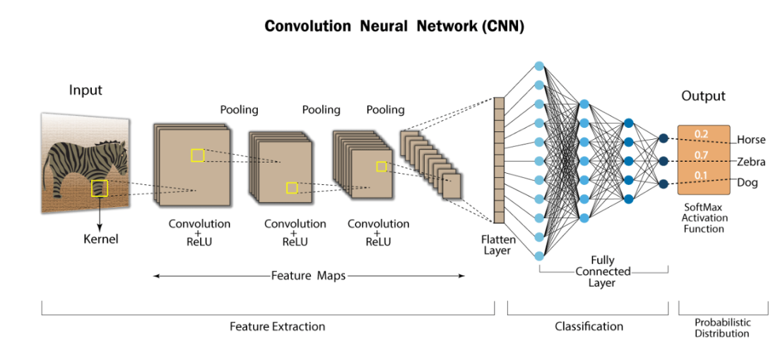

Slide 6
Components of CNN
The CNN model works in two steps:
feature extraction
Classification
Feature Extraction is a phase where various filters and layers are applied to the images to extract the information and features out of it and once it’s done it is passed on to the next phase
Classification where they are classified based on the target variable of the problem.

Slide 7
A typical CNN model looks like this:
Input layer
Convolution layer + Activation function
Pooling layer
Fully Connected Layer

Slide 8
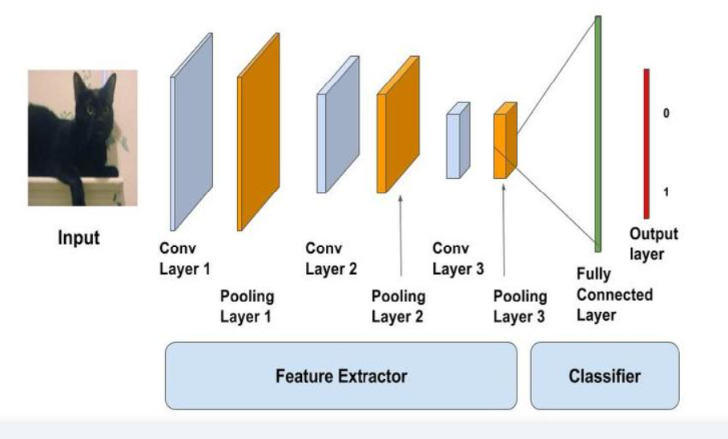

Slide 9
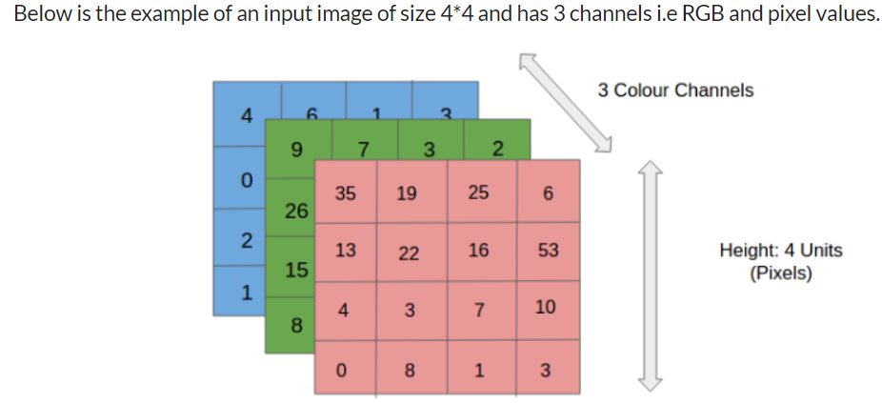
Input layer
As the name says, it’s our input image and can be Grayscale or RGB. Every image is made up of pixels that range from 0 to 255. We need to normalize them i.e convert the range between 0 to 1 before passing it to the model.

Slide 10
Convolution Layer
The convolution layer is the layer where the filter is applied to our input image to extract or detect its features.
A filter is applied to the image multiple times and creates a feature map which helps in classifying the input image.

Slide 11
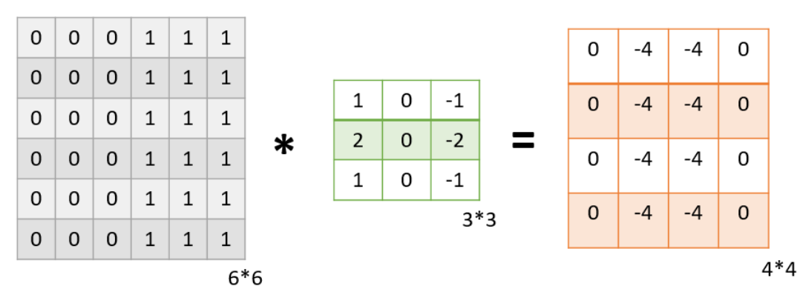

Slide 12
The result of applying the filter to the image is that we get a Feature Map of 4*4 which has some information about the input image. Many such feature maps are generated in practical applications.

Slide 13
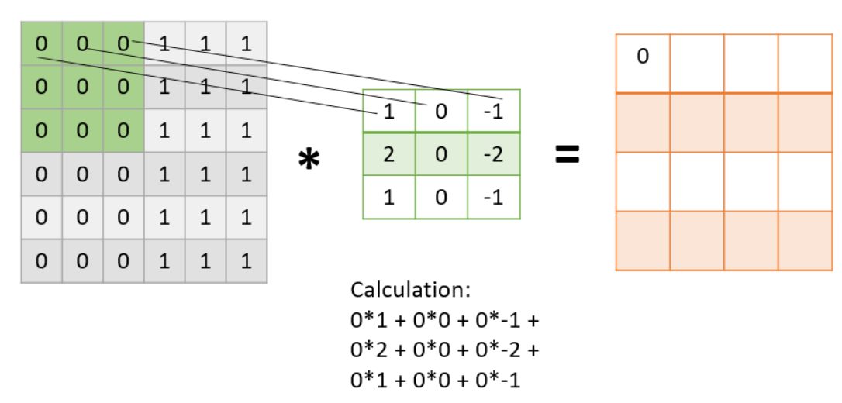

Slide 14
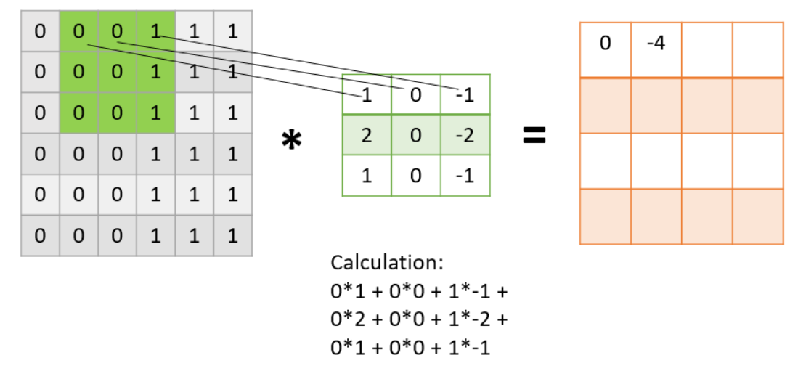

Slide 15
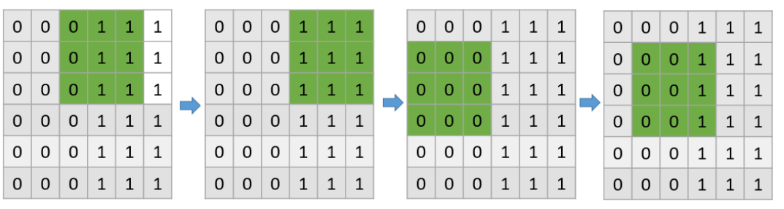

Slide 16
Pooling Layer
The pooling layer is applied after the Convolutional layer and is used to reduce the dimensions of the feature map which helps in preserving the important information or features of the input image and reduces the computation time.
Using pooling, a lower resolution version of input is created that still contains the large or important elements of the input image.
The most common types of Pooling are Max Pooling and Average Pooling. The below figure shows how Max Pooling works.

Slide 17
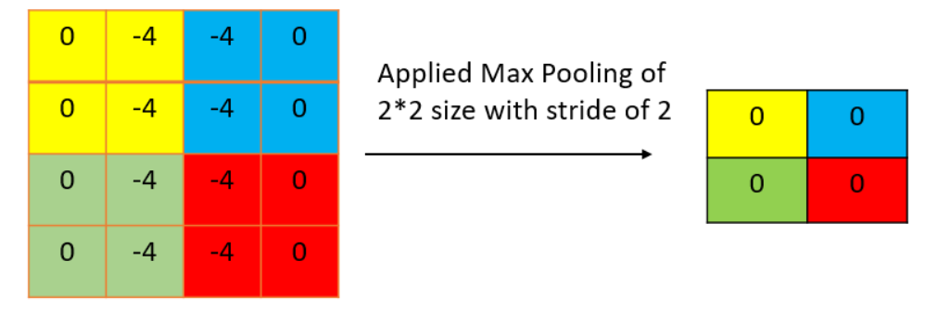
Pooling layer of size 2*2 with a stride of 2.
The maximum value from each highlighted area is taken and a new version of the input image is obtained which is of size 2*2 so after applying Pooling the dimension of the feature map has reduced.

Slide 18
Fully Connected Layer
The Fully connected layer (as we have in ANN) is used for classifying the input image into a label.
This layer connects the information extracted from the previous steps (i.e Convolution layer and Pooling layers) to the output layer and eventually classifies the input into the desired label.

Slide 20
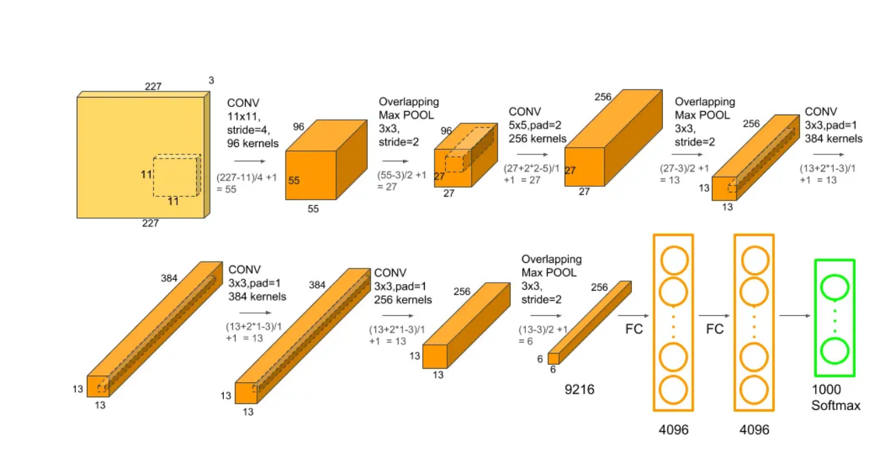
AAAa

